Slide 1


Now you have zero problems:
Verification of realistic regex matching
Marcin Wojnarowski
Supervisors: Dr. Aurèle Barrière, Prof. Clément Pit-Claudel
Notes:
Can we trust the optimizations of regex matching algorithms?

Slide 2
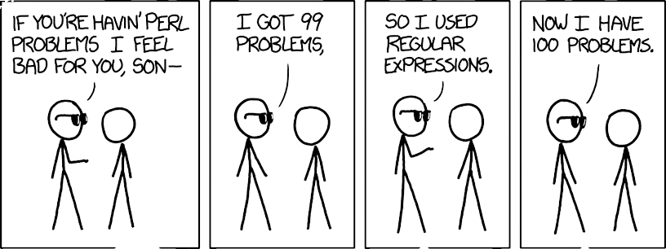
Introduction | 1 of 25
https://xkcd.com/1171

Slide 3
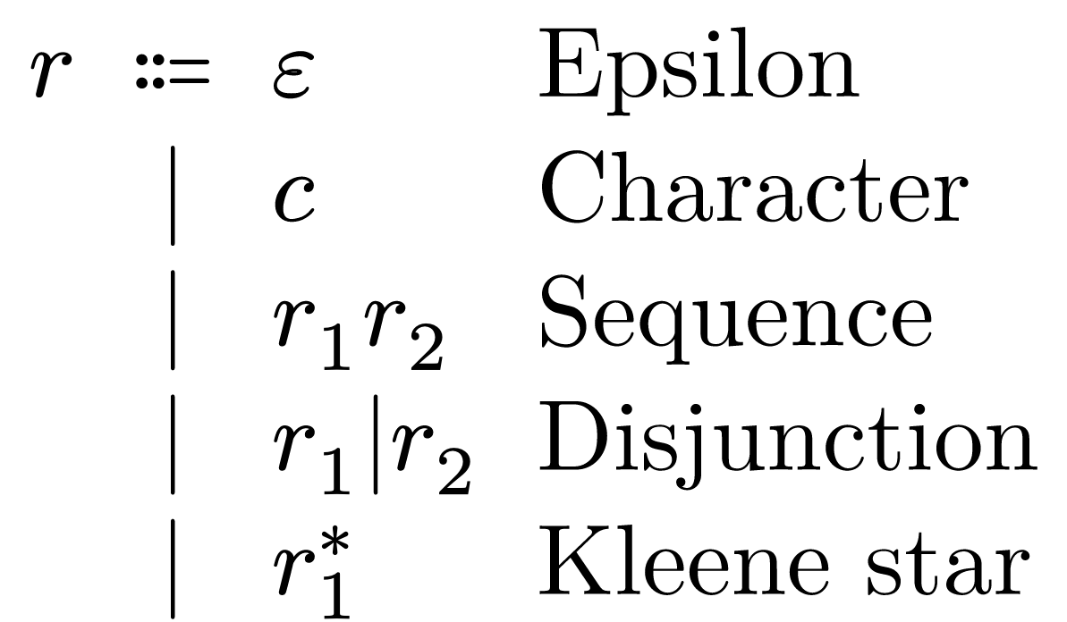
Introduction | 2 of 25
Notes:
How can these 5 cute rules be scary?

Slide 4
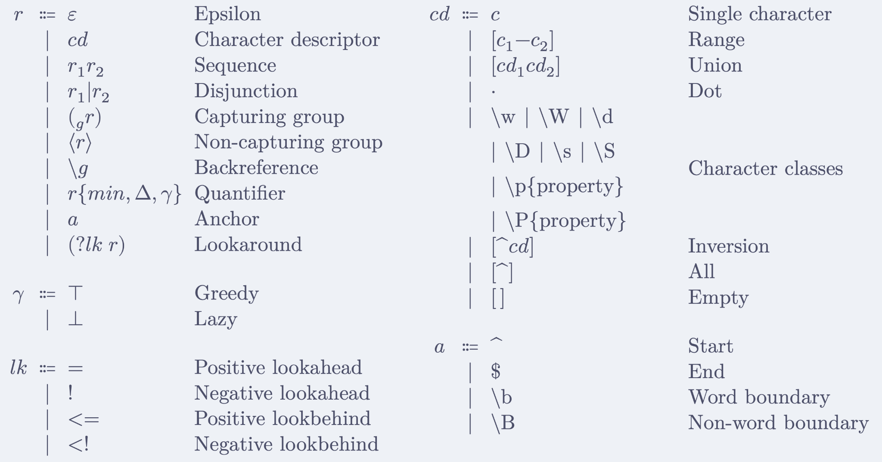
Modern syntax
Introduction | 3 of 25
Notes:
As we know references have no track record of making our lives difficult in computer science

Slide 5
Modern semantics: fundamental questions
Introduction | 4 of 25
Given a regex r and string s
Does r match in s?
Where is the highest priority match?
What are the values of capture groups?
/a(b|be)w+/
"ababcccccabeww"

Slide 6
Are backtracking semantics used by anyone?
Introduction | 5 of 25
ECMAScript
C++
Python
Rust
Java
Golang
.NET
Perl
PHP
Dart
Ruby
Raku
Julia
D
Erlang
Yes.
Notes:
Commonly known under the Oracle trademark of "JavaScript"
Safe to say we are dealing with non-toy semantics

Slide 7
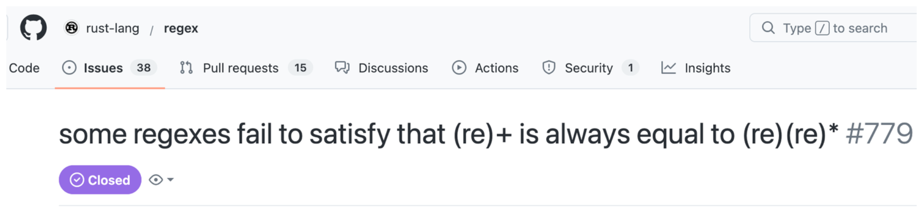

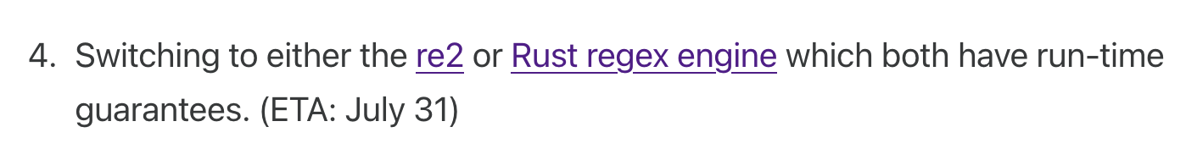

Why formalize?
Introduction | 6 of 25
Notes:
When cloudflare goes down, half of the internet goes down
These libraries do much more than what was formalized

Slide 8
Previous work
Introduction | 7 of 25
Verified: full backtracking semantics in Rocq
Safe: mechanized and proven correct linear-time matching algorithm (PikeVM)

Slide 9
Modern optimizations
Introduction | 8 of 25
Prefix acceleration
Anchored searches
Heuristics
Reverse searches
SIMD
Combining engines
Impossible matches
Literal tries
JIT
Multiple needles searches

Slide 10
Previous work
This work
Introduction | 9 of 25
Verified: full backtracking semantics in Rocq
Safe: mechanized and proven correct linear-time matching algorithm (PikeVM)
3. Realistic: mechanized and proven correct optimizations to speed up matching
Prefix acceleration
  Literal extraction
  Substring searches
Meta engine
  Anchored searches
  Impossible matches
Notes:
I will colorcode with magenta my contributions
Bridge the gap between fast dangerous matching algorithms and

Slide 11


Verification of realistic regex matching
+ optimizations
Marcin Wojnarowski
Supervisors: dr. Aurèle Barrière, prof. Clément Pit-Claudel
Notes:
Verification: everything formalized and proven in Rocq
Realistic regex matching: not a toy example

Slide 12
Agenda
Introduction | 11 of 25
PikeVM
Prefix acceleration
Conclusions
Notes:
The emphasis will be on prefix acceleration

Slide 13
PikeVM
PikeVM | 12 of 25
Rust
Golang
RE2
V8
Notes:
RE2 which in turn is used by many other libraries
But other languages have reimplemented it

Slide 14
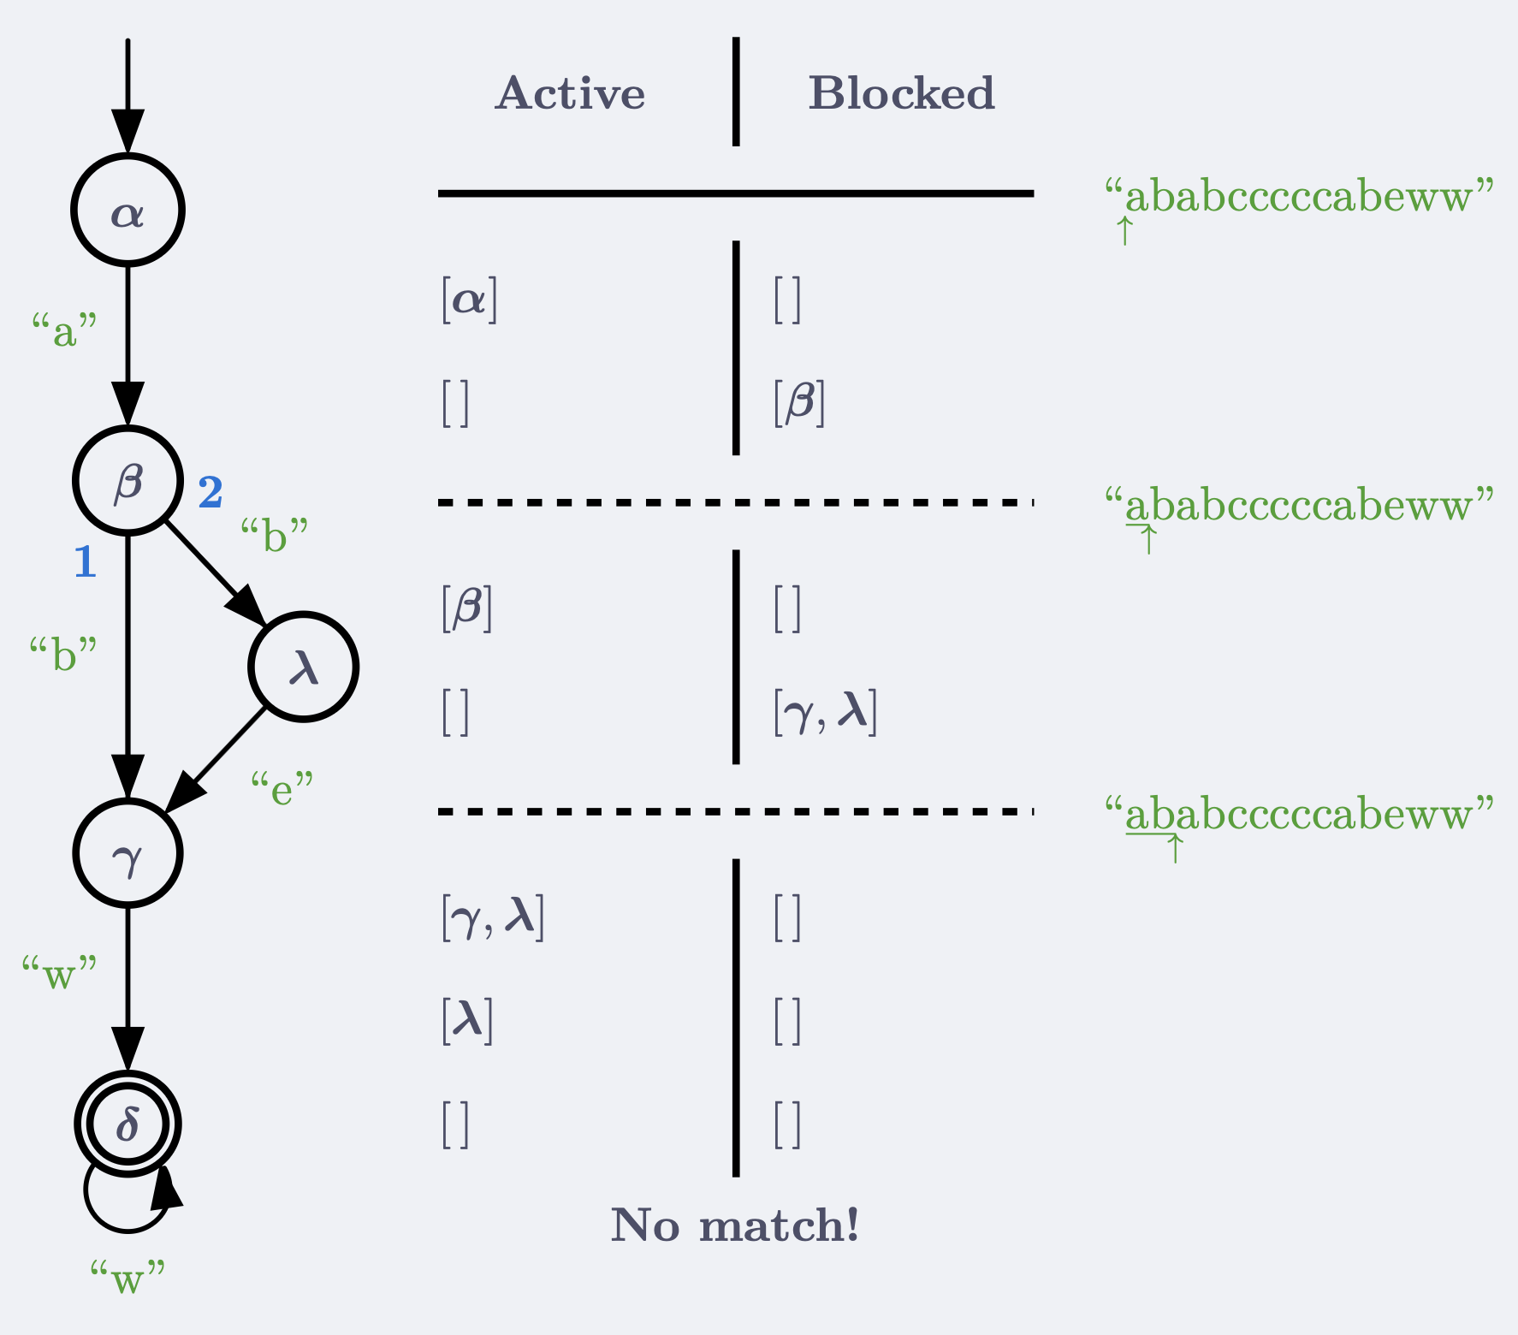

PikeVM | 13 of 25
Notes:
Extended NFA

Slide 15
PikeVM | 14 of 25
"ababcccccabeww"
But… there is a match!
Anchored vs unanchored
Just run the anchored engine at every position
𝑂(|𝑟| ⋅ |𝑠|²) nevermind…

Slide 16
How to make the PikeVM unanchored?
PikeVM | 15 of 25
Before | After
Active = Blocked Blocked = [ ] | Active = Blocked ++ [𝜶] Blocked = [ ]
Notes:
Let's make this extension efficient
We use the information about regex literals to speed this up

Slide 17
Prefix acceleration
Prefix acceleration | 16 of 25
Leveraging prefixes of regexes to accelerate over parts of the string.

Slide 18
Prefix of regexes
Prefix acceleration | 17 of 25
prefix(
) = "ab"...
Theorem: all matches must start with prefix
Contrapositive: if at some position we do not have prefix, a match cannot exist there

Slide 19
Unanchored PikeVM
Prefix acceleration | 18 of 25
Keep a counter of when next the prefix will match
Attach the 𝜶 state
Use the counter together with the Contrapositive theorem of prefix extraction to optimize

Slide 20
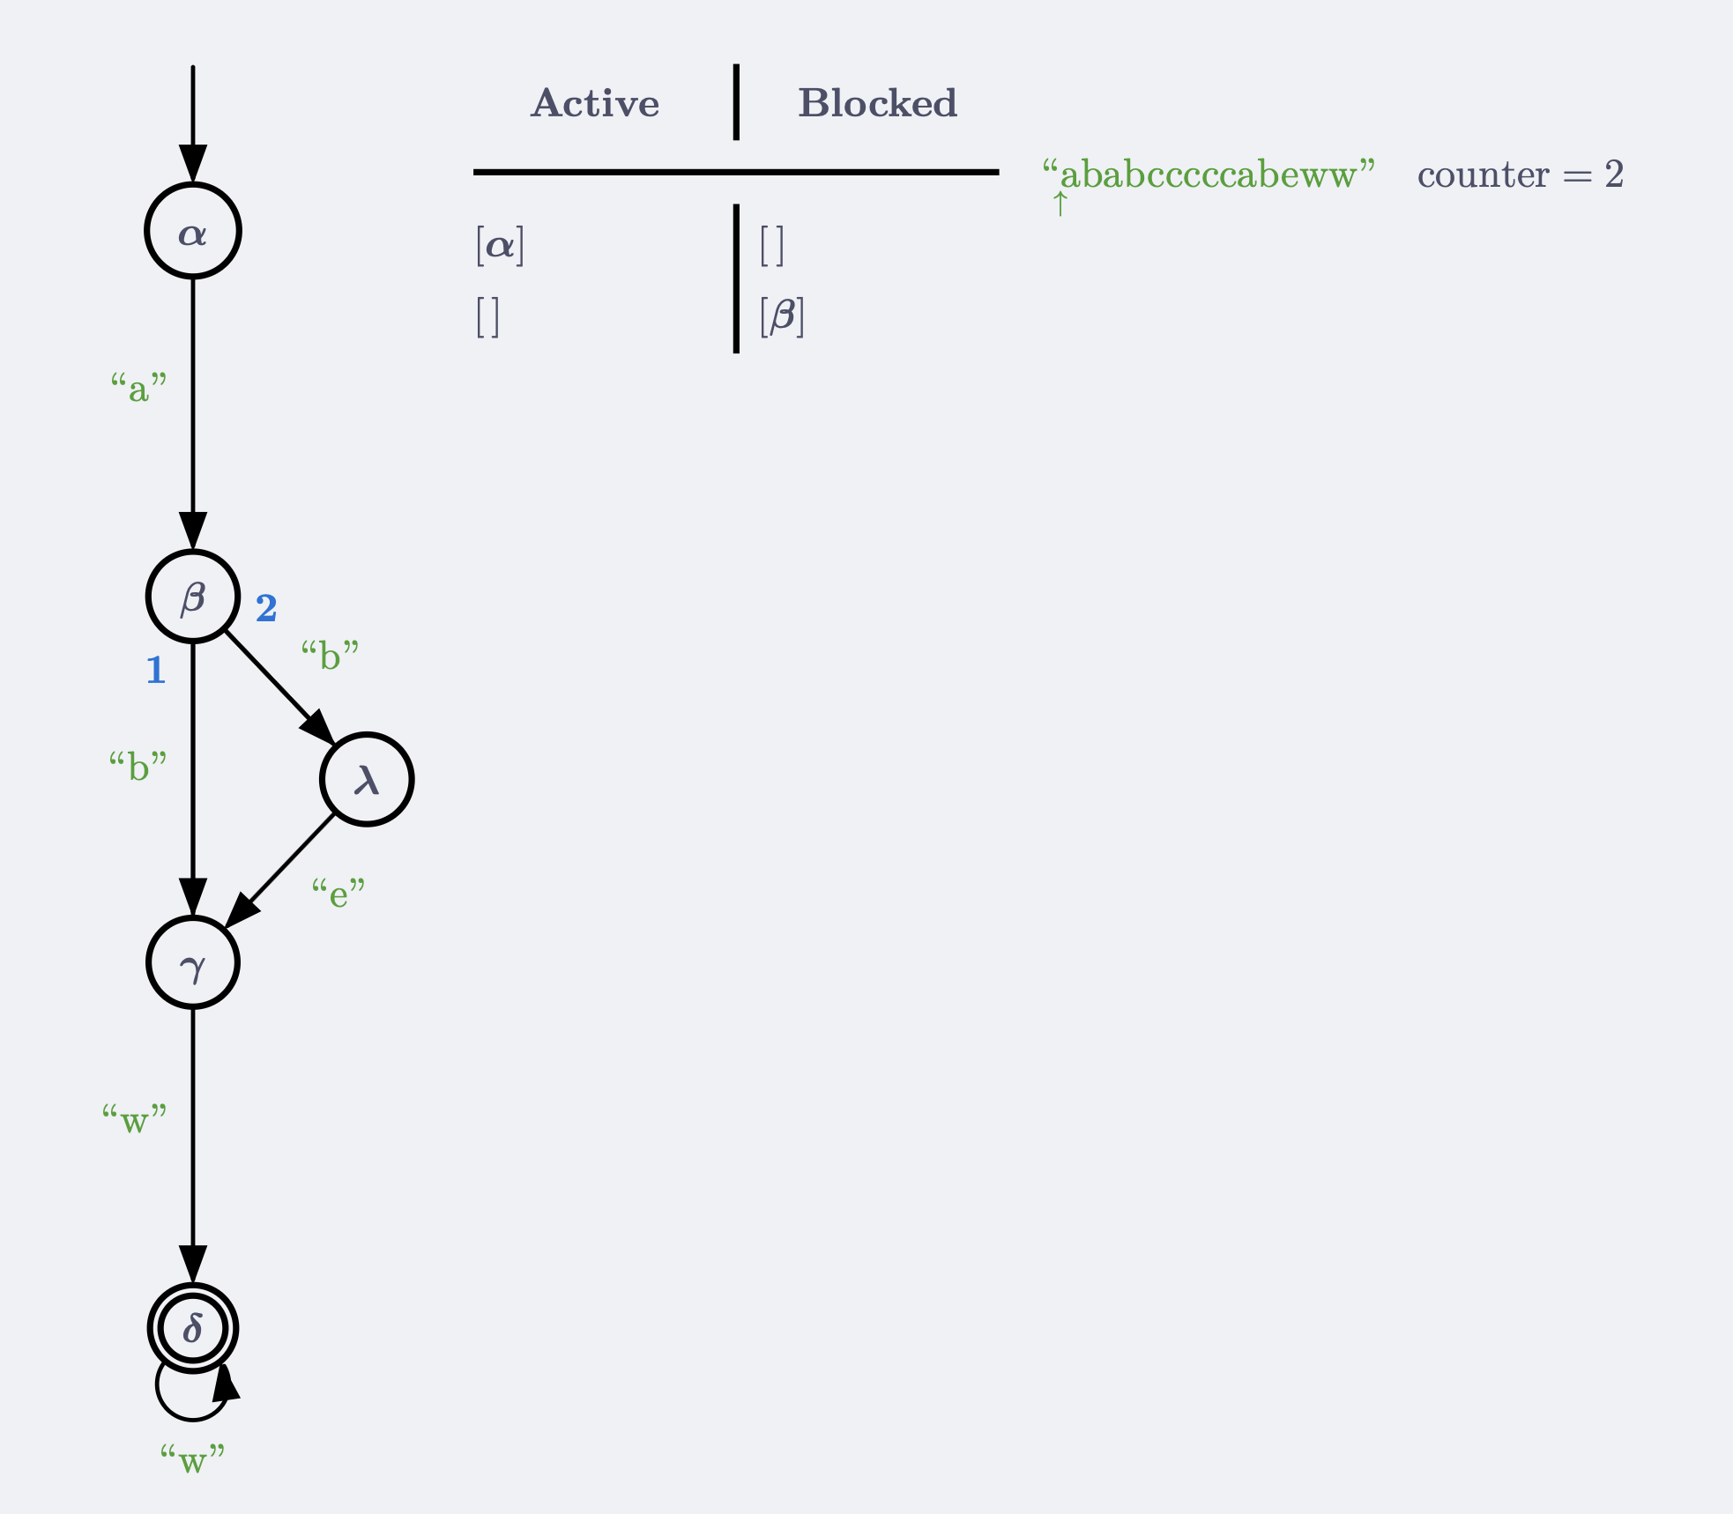
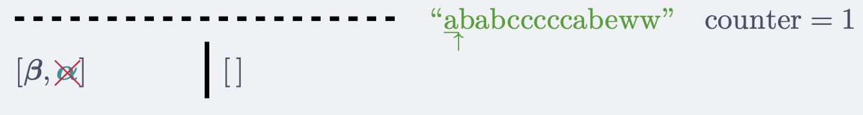
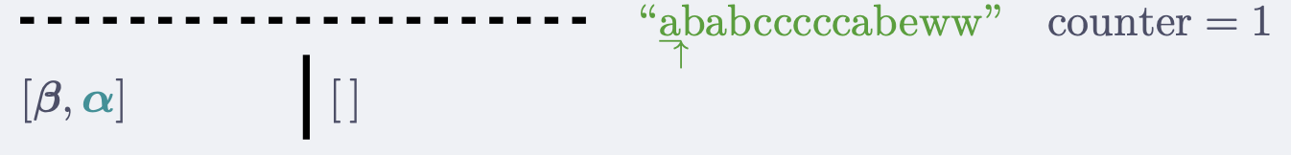
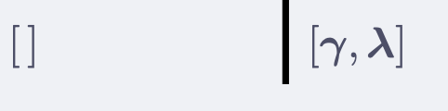
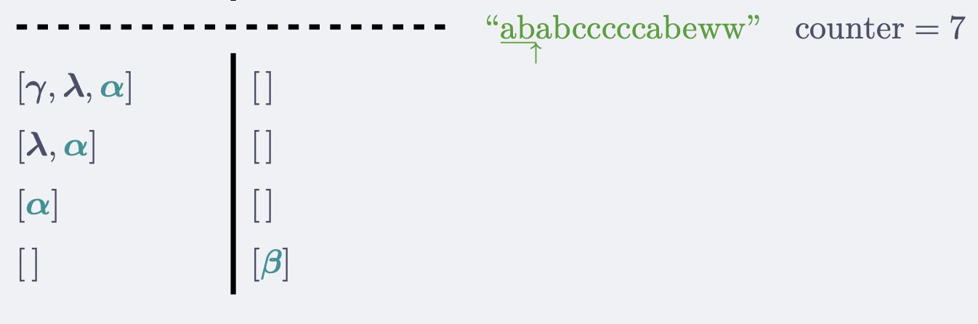
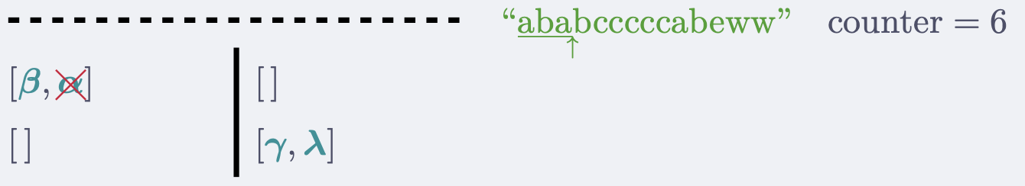
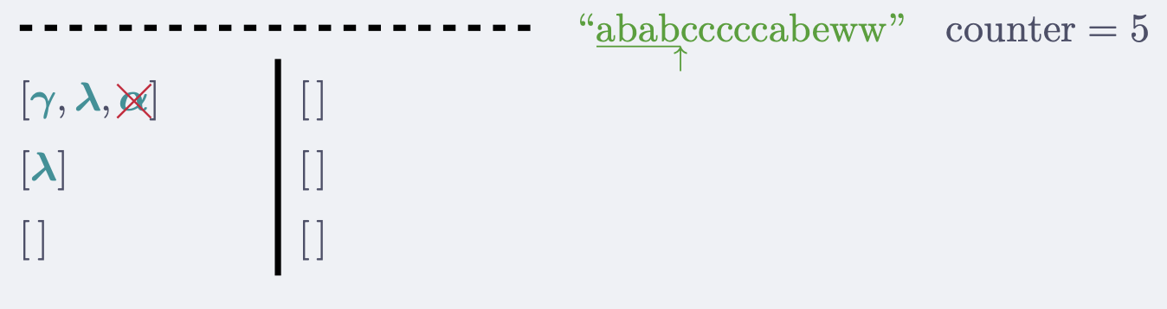
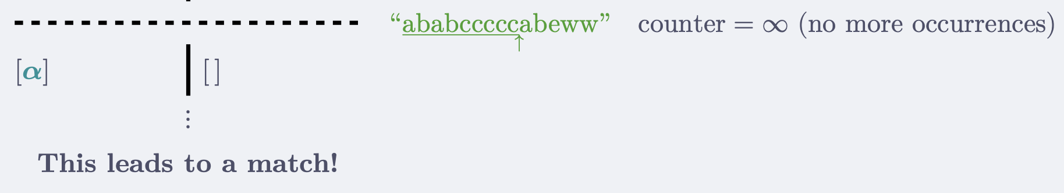
Prefix acceleration | 19 of 25
Filtering
Filtering
Filtering
Acceleration

Slide 21
Evaluation of the unanchored PikeVM
Prefix acceleration | 20 of 25
Rust's regex library + rebar regex benchmark suite²
Acceleration: up to 600× speed up!
Filtering (novel): up to 20× speed up!
Analyzed a corpora of 1,5 million regexes³
66% of those have a meaningful prefix
The most important optimization
Verified unanchored PikeVM, well known acceleration, novel filtering
²https://github.com/LindenRegex/rebar/tree/mw/prefix-acc-cmp
³https://doi.org/10.1145/3236024.3236027
Notes:
Rebar tries to model real-world regex usage

Slide 22
Unanchored PikeVM verification challenge
Prefix acceleration | 21 of 25
The existing proof pipeline is large, we want to reuse as much as possible.
Success:
anchored PikeVM ⇔ unanchored PikeVM with counter = ∞
Notes:
Getting Qed was only part of the goal
This has been successful. The unanchored pikevm is just the pikevm with the counter initialized
Let's see what we need to bridge to prove the correctness

Slide 23
Conclusion
Conclusions | 22 of 25

Slide 24
Conclusion
Future work
Conclusions | 23 of 25
Proved the correctness of an unanchored PikeVM utilizing prefix acceleration
  Novel extension through filtering
Realistic regex matching algorithm
Everything formalized in Rocq
Contribute filtering to rust regex
Lookarounds in PikeVM (ongoing)
Verified extraction to a library (ongoing)

Slide 25

Documentation
Conclusions | 24 of 25
Report
This presentation
Progress reports
Permalinks for:
  Rocq formalization
  Rust regex implementation
  Regex benchmarks
  Frequency analysis
Everything needed to reproduce the results
https://github.com/shilangyu/pikevm-systemf
Notes:
I have put a lot of care into making everything accessible and reproducible

Slide 26
Merci
Merci | 25 of 25

